Slide 1

BIGFIX

Slide 2
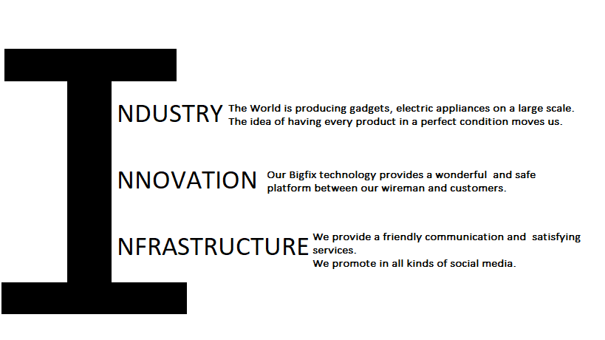
SUSTAINABLE DEVELOPMENT GOAL

Slide 3


INTRODUCTION
This is a unique website for issues with electrical appliances so that u can get both online assistance and offline assistance from service centers as well as local electricians at any time by booking slots on demand .Nowadays as it not possible for people to go out more often .These people can seek assistance and can be benefitted through our BigFix .This is a platform between people inclined to work and those who want the work to be done .

Slide 4

WHAT IS OUR AGENDA?
To provide assistance to people in need for the repairs of their electrical appliances.
Immediate assistance
Suitable Time Frames
Professional and quality works
To provide good feedback to the customer and good credits and benefits to the professionals
Spread awareness about good facility works provided

Slide 5

SERVICES PROVIDED THROUGH BIGFIX
Gadget Repairs
Home appliances repairs
Professional electricians for assistance

Slide 6

BENEFITS TO THE CUSTOMERS & PROFESSIONALS
After the service provided the customers will be able to rate the professionals. According to their feedback virtual coins will be added to the professional through which other customers will also get an idea about the work quality or the service provided by the professional or service centers.

Slide 7

SAFETY MEASURES DURING THE PANDEMIC
Hygienic and proper sanitized professionals with their body temperature visible in the website also online assistance through chats and calls will be provided. Masks and gloves will be mandatory for professionals to provide offline assistance also the customer will have to provide their accurate body temperature for the safety of the local professional or service center professional .

Slide 8

PROTOTYPE: UI/UX DESIGNS CREATED BY OUR TEAM BIG FIX

Slide 9
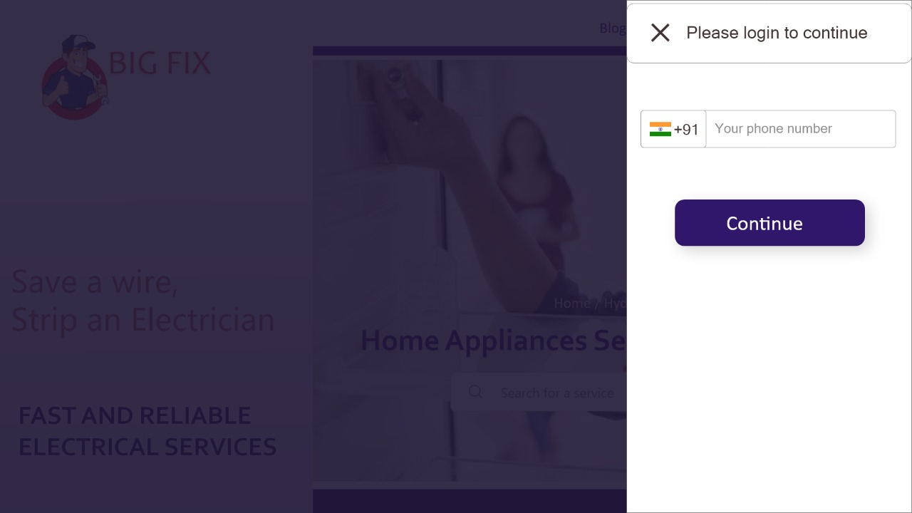
THE LOGIN PAGE

Slide 10
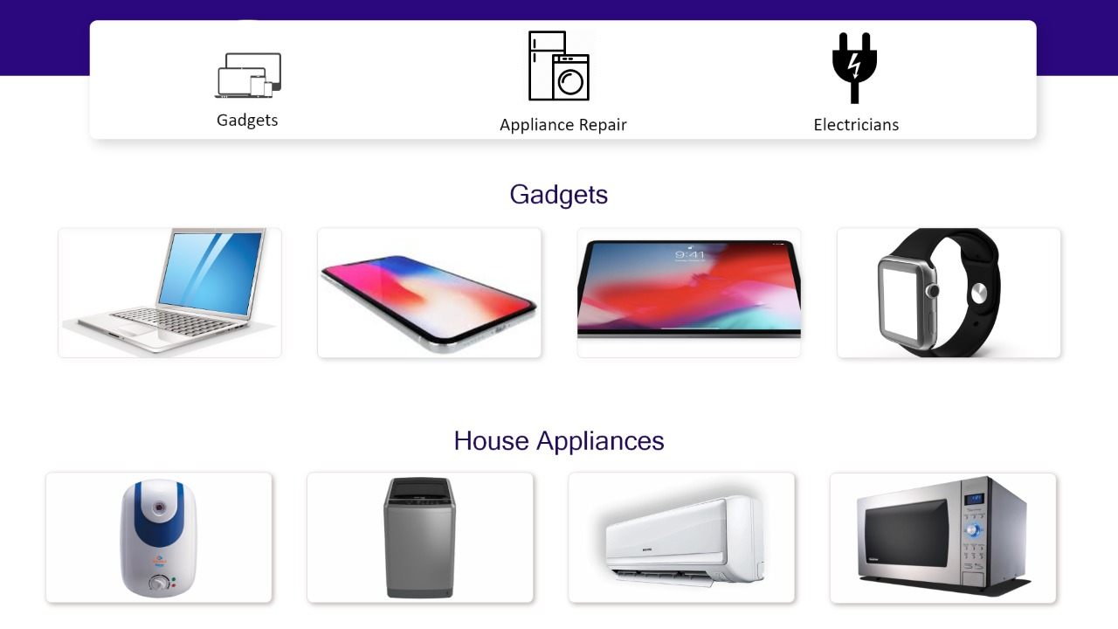
CHOOSING THE CATOGERY

Slide 11
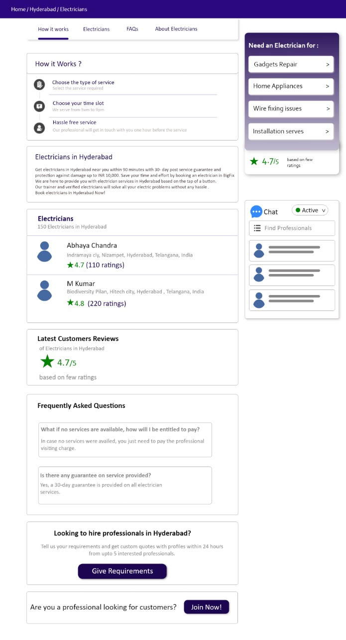

Slide 12
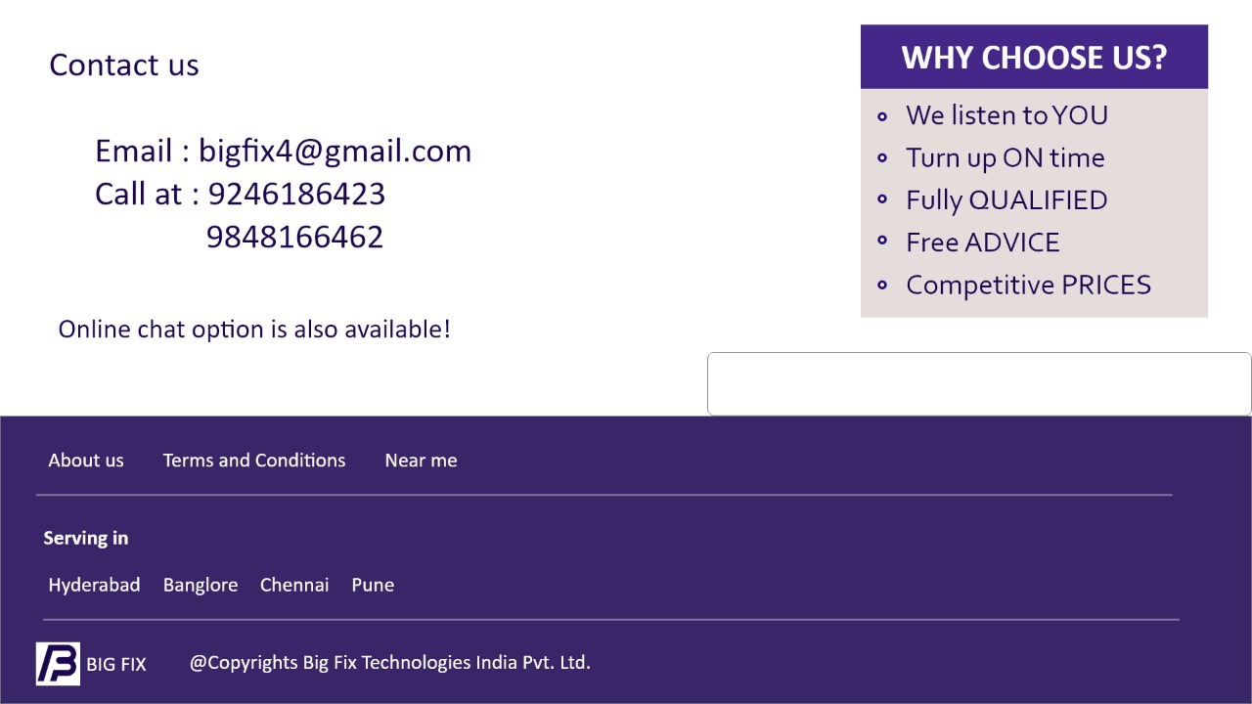

Slide 13

TOOLS USED FOR DEVELOPMENT
FRONT END : ADOBE XD ,ADOBE ILLUSTRATOR, ADOBE PHOTO SHOP
BACK END: WIX ,SQUARESPACE USING JAVASCRIPT AND PYTHON LANGUAGES

Slide 14
ABOUT US
We are students pursuing Bachelor of Technology degree from VIT – AP in Computer Science presently in second year and we are enthusiastic to learn new things and work on new concepts. We are Team BigFix
UI/UX designer : Srineha Gaddam
Content Writer : Sai Aishwarya Darisipudi
Web Developer : Meela Neha
Marketing & Back end developer: Ravindranath Gavirneni

Slide 15
Conclusion
Our motto through this website is to provide help to the society in staying updated and to reach people easily and also to eradicate unemployment and provide a chance to people whose works are worth and are well qualified. Also in the Indian society there is no much respect for electricians and other workers who are willing to do good work so we want to give them the respect they deserve by making them professionals and integrating them with us .

